Slide 1
Saturday, April 2, 2016
WVU School of Dentistry
Robert C. Byrd Health Sciences Center
Morgantown, WV
8:30-5:00 PM

Slide 2
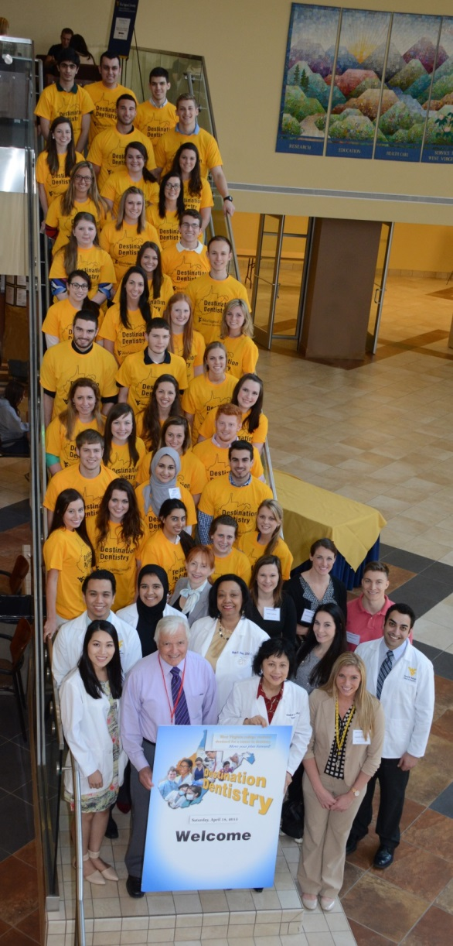
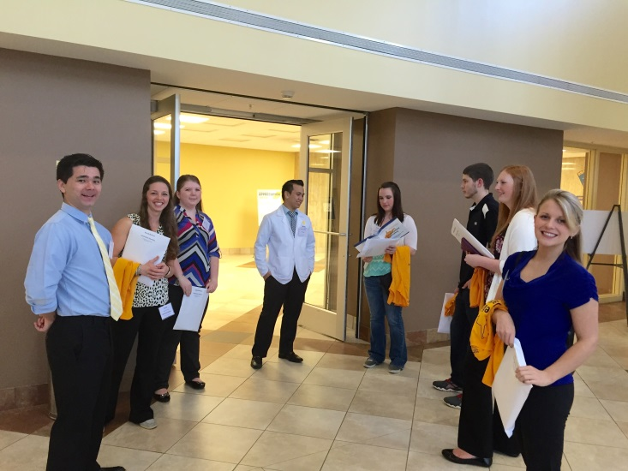
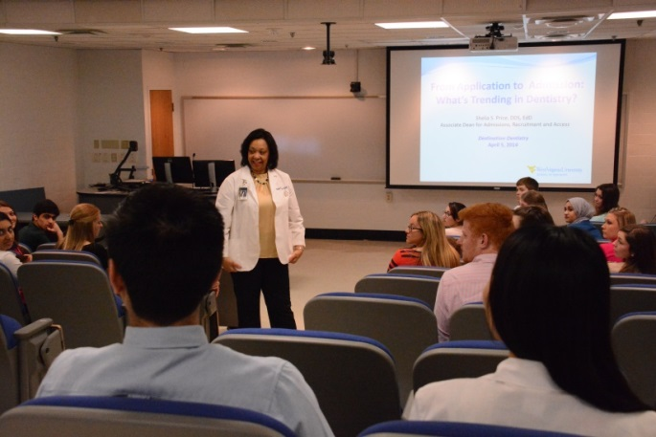
Dental students and participants mingle before group tours begin
Destination Dentistry 2015
Participants and Presenters
Dr. Price and participants “break the ice”

Slide 3
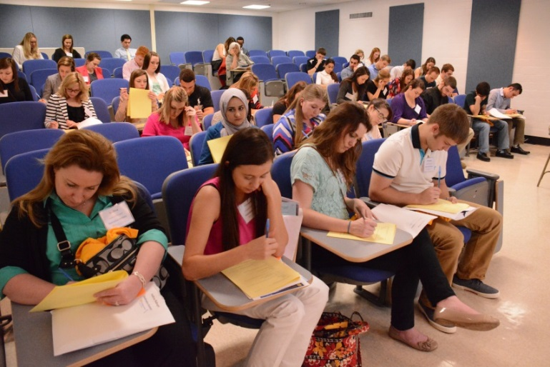
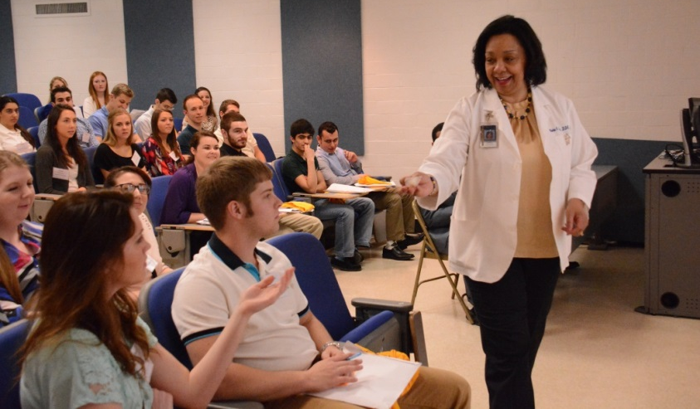
Destined for Dentistry: Preparing Your Best Dental School Application
What do You Already Know?
Participants complete a quick pre-survey to determine their knowledge prior to the program beginning
What is the Application Process?
Dr. Price solicits answers to admission questions and hands out a reward

Slide 4
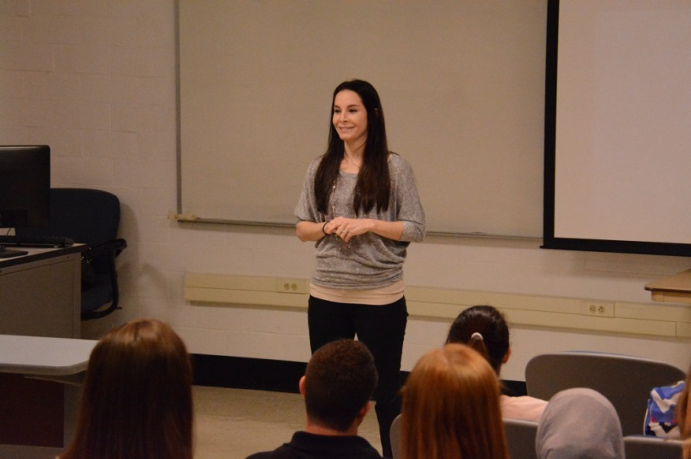
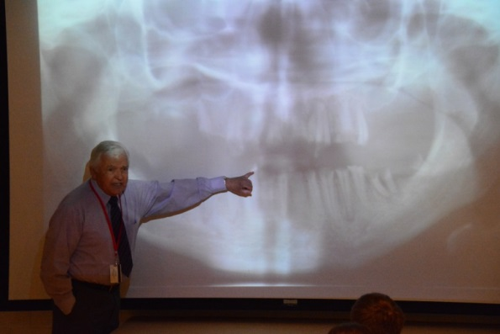
Discuss issues facing dentistry today
Dentistry 2016: Rewards and Challenges
Dr. Robert Stuchell talks about new developments in dentistry, the impact of popular trends in oral health, and the importance of proper oral hygiene
Dr. Shelby Alexander discusses “Comprehensive Dentistry: From Congenitally Missing Teeth to Extreme Wear”

Slide 5
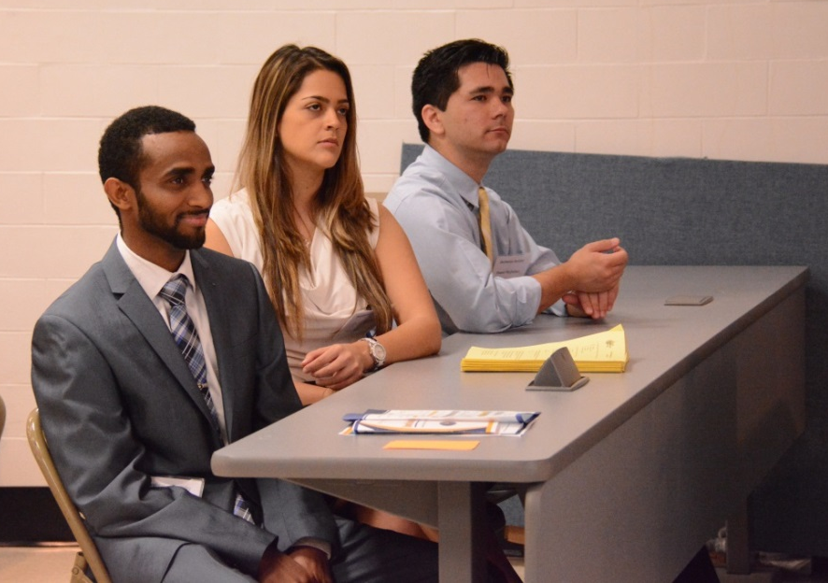
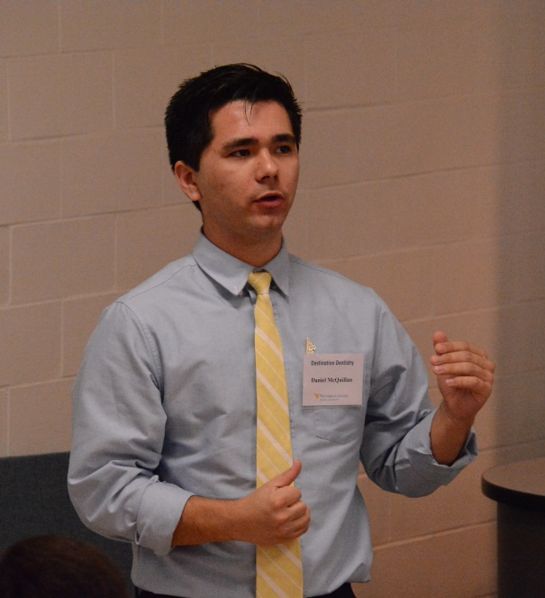
Admissions Experiences
Dental students Ermias Semaie, Grace Garcia and Daniel McQuillan take questions from the audience about their application experiences
Going from Dental Applicant to Dental Student
Daniel McQuillan offers insightful suggestions

Slide 6
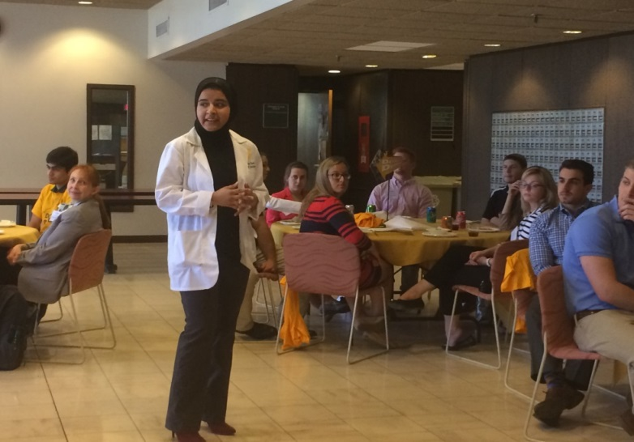
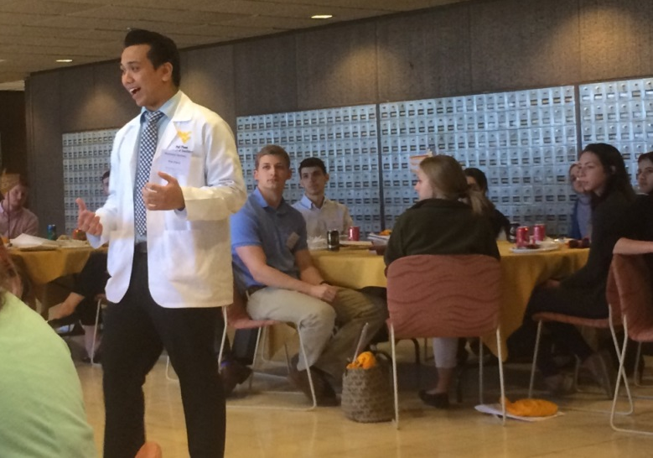
Lunch-and-Learn
Ameena Syed describes her gratifying experiences in the patient clinic
Phil Pham a forth-year dental student discusses his rural rotation experience and finalizing his patient care before graduation in a few weeks
Participants have one-on-one and group opportunities to speak with dental students and faculty

Slide 7
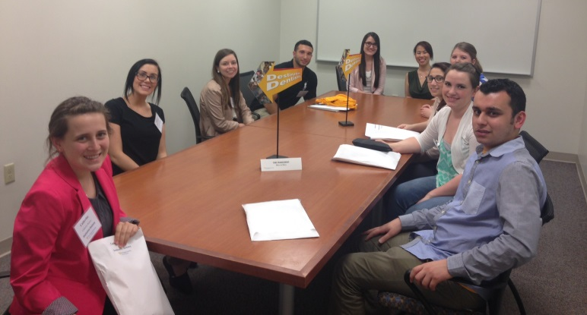
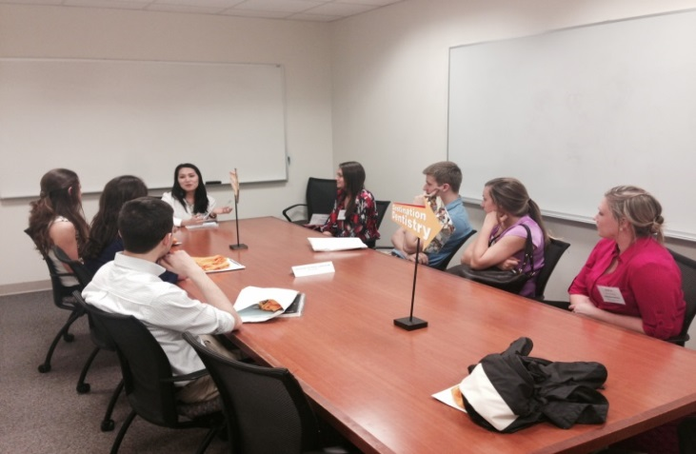
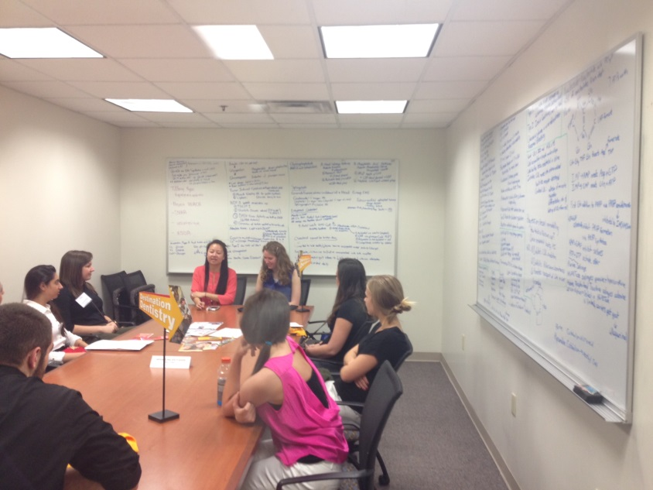
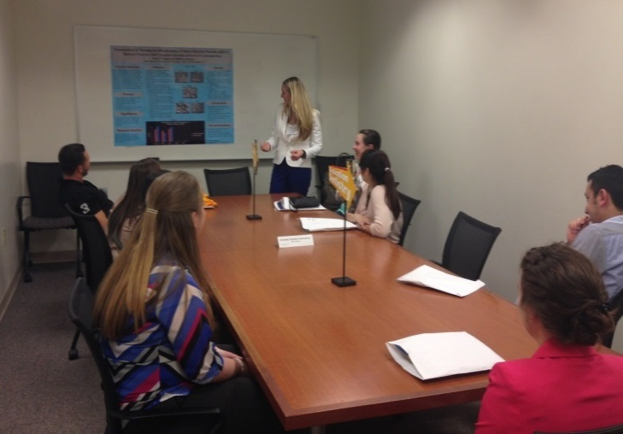
“Bits and Bites”
Victoria Schmitt and Mannuh Iglesias give tips on time management
Jennifer Nguyen discuss how to navigate the dental curriculum
Tiffany Ngan talks about how even as dental students, they work toward improving oral health access
Kerri Thomas discusses her research project and the various research opportunities at the school

Slide 8
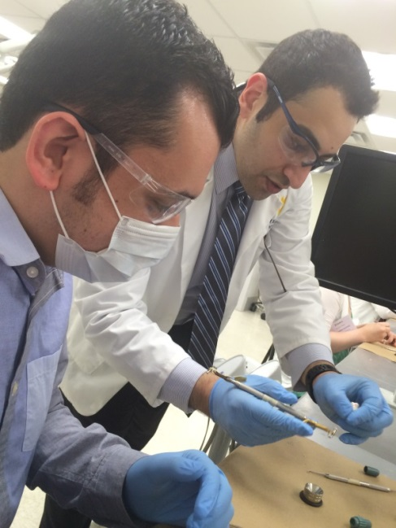
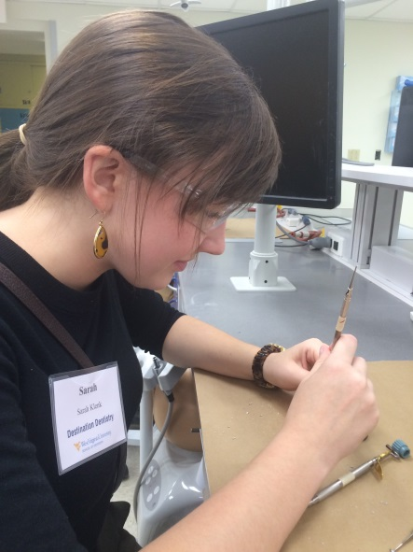
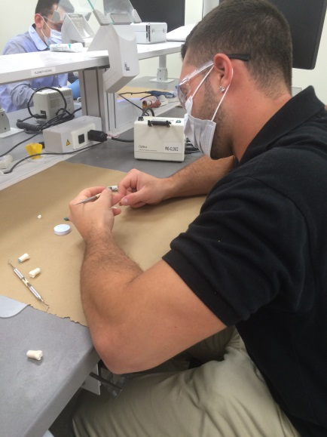
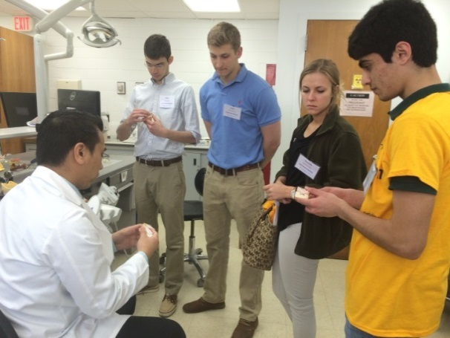
Hands-On Experiences
Homed Motlagh demonstrates how to prepare the tooth.
Participants work on their own after being shown how to complete the task.
Phil Pham shows participants various dental models.

Slide 9
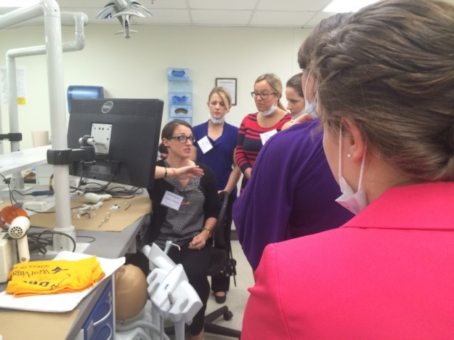
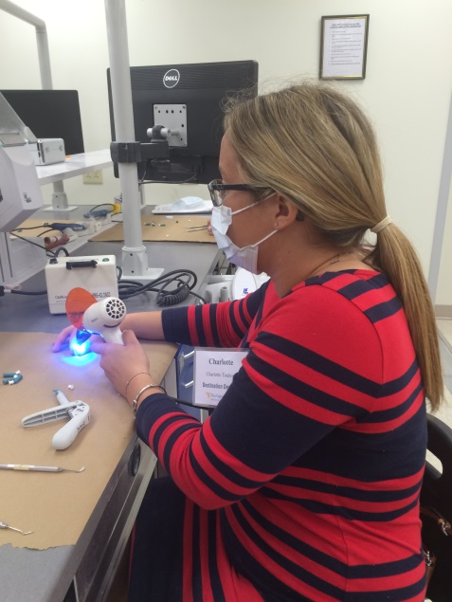
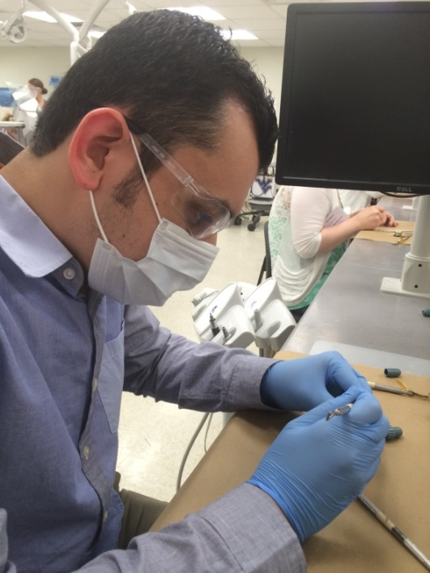
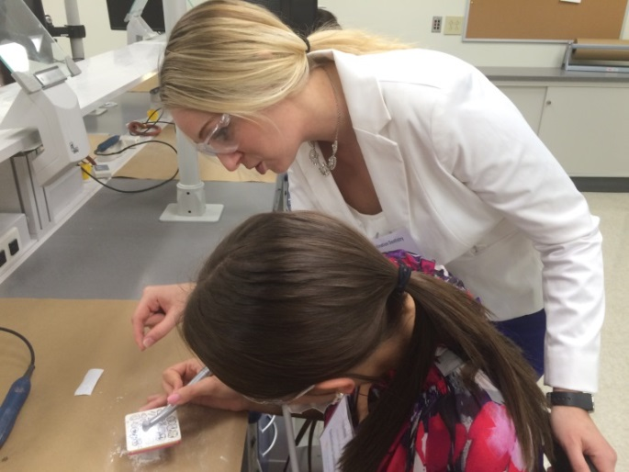
More hands-on…
Amanda Lundstrom explains how to use the equipment before participants begin
Kerri Thomas assists a participant

Slide 10
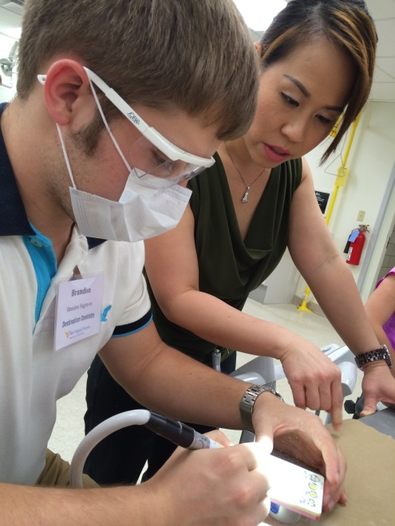
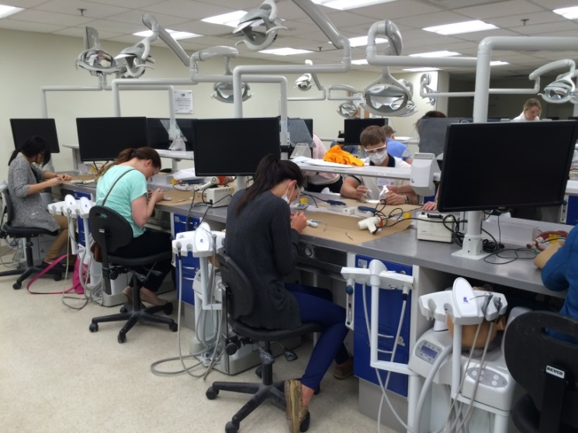
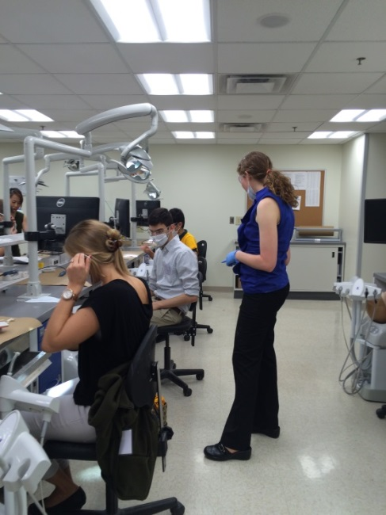
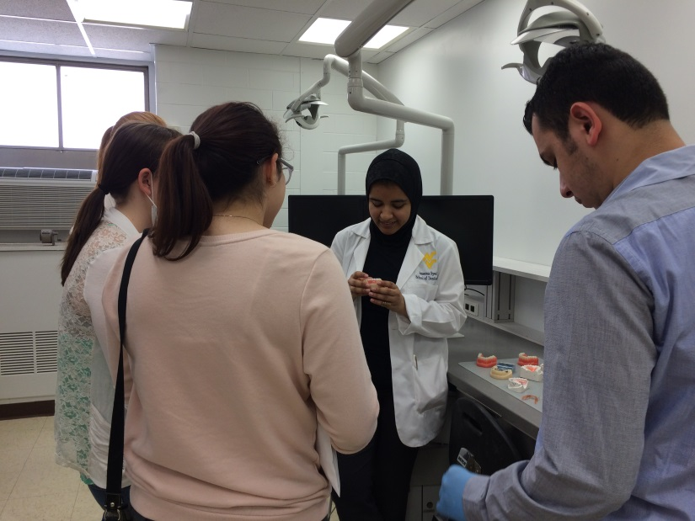
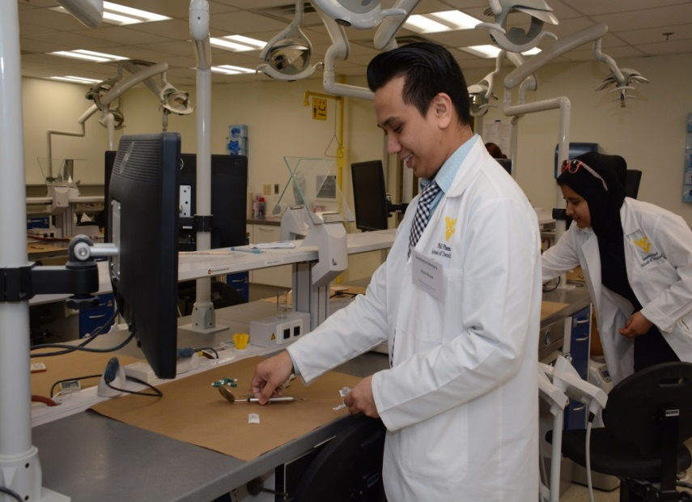
Experience the Simulation Laboratory!

Slide 11
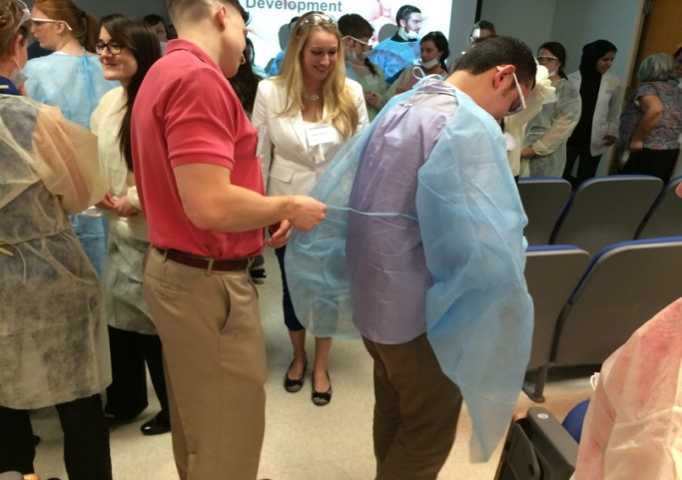
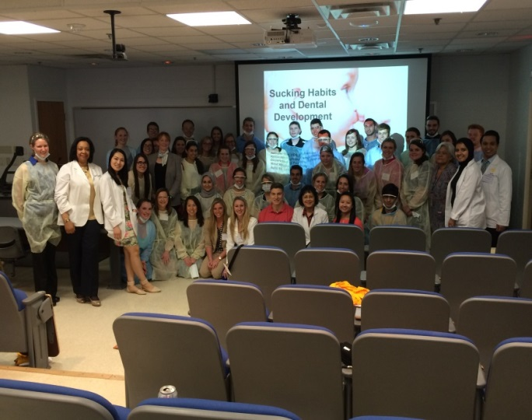
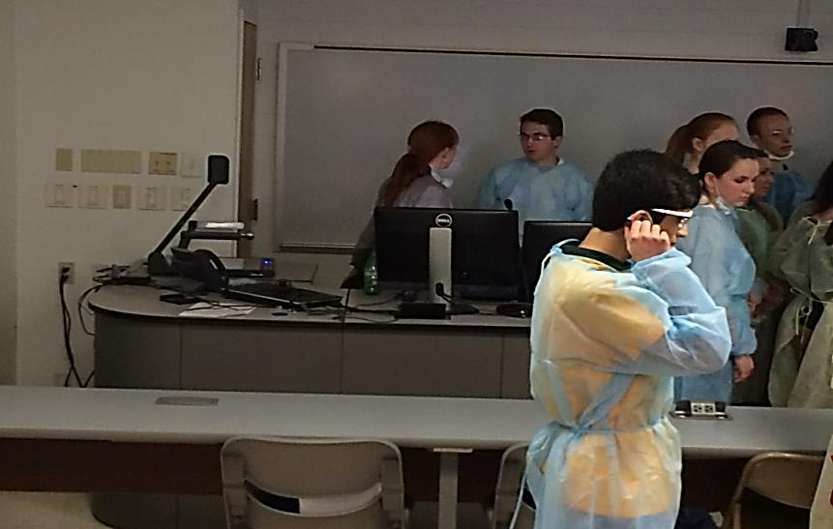
Learn About Infection Control and PPE!
Mark Gardner assists a participant with putting on his gown before gross anatomy lab
Participants, presenters and dental students pose for a quick photo to show off their gear
The participants get dressed in their gowns

Slide 12
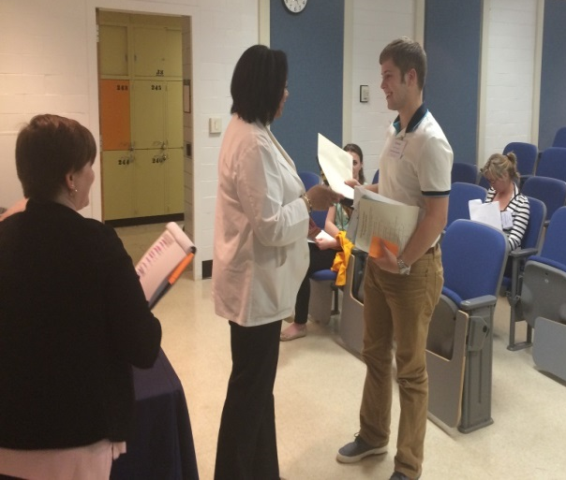
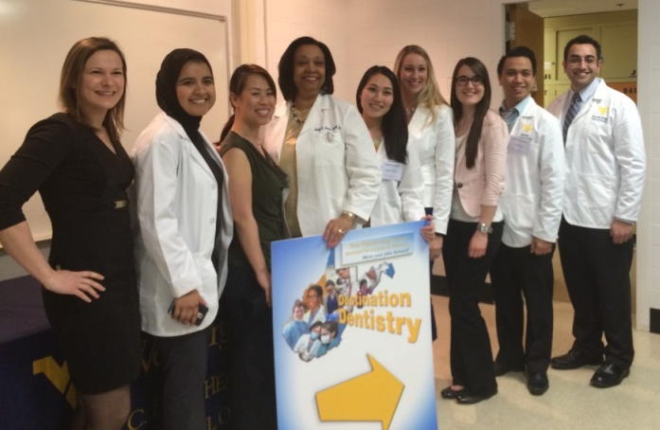
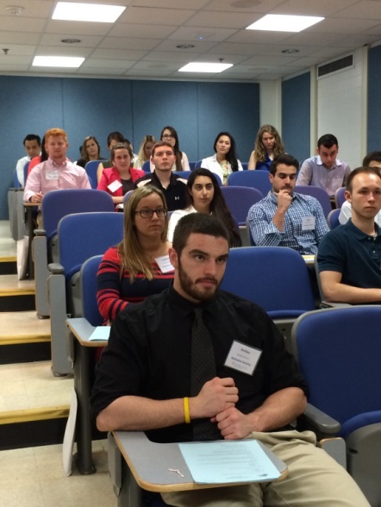
Bon Voyage!
Dr. Price thanks participants for attending and presents them with a certificate and gift
Before saying goodbye participants complete their post-assessment quiz
Nicole Andreini, Ammena Syed, Mannhu Iglesias, Dr. Price, Jennifer Nguyen, Kerri Thomas, Victoria Schmitt, Phil Pham and Hom Motlagh take one last picture at the end of the day

Slide 13
WVU School of Dentistry Office of Admissions, Recruitment, and Access
Shelia S. Price, DDS, EdD Associate Dean for Admissions, Recruitment, and Access Sprice@hsc.wvu.edu
Kristi Martin Administrative Assistant Kristi.Martin@hsc.wvu.edu
Tanner Coles, MPH Administrative Secretary Twcoles@hsc.wvu.edu

